Slide 1
Unit 1
Lecture 4
Visibility modifiers, Methods, Constructors, Method overloading, Static members, Use of this reference.

Slide 2
Key Characteristics of Java Arrays:
Homogeneous: All elements within an array must be of the same data type (e.g., int, String, Object).
Fixed Size: The length of an array is determined at the time of its creation and cannot be changed afterward.
Zero-Based Indexing: Elements are accessed using a numerical index, starting from 0 for the first element.
Objects: Arrays in Java are objects themselves, implicitly inheriting from java.lang.Object. This means they have methods like toString(), equals(), and a length property to get the number of elements.

Slide 3
class Student { public int roll_no; public String name; Student(int roll_no, String name){ this.roll_no = roll_no; this.name = name; }} public class Aoa{ public static void main(String[] args){ // declares an Array of Student Student [] arr; // allocating memory for 5 objects of type Student. arr = new Student[5]; | // initialize the elements of the array arr[0] = new Student(1, "aman"); arr[1] = new Student(2, "vaibhav"); arr[2] = new Student(3, "shikar"); arr[3] = new Student(4, "dharmesh"); arr[4] = new Student(5, "mohit"); // accessing the elements of the specified array for (int i = 0; i < arr.length; i++) System.out.println("Element at " + i + " : { " + arr[i].roll_no + " " + arr[i].name+" }"); }}
Notes:
Arrays of Objects in Java
An array of objects is created like an array of primitive-type data items
Example: Here we are taking a student class and creating an array of Student with five Student objects stored in the array. The Student objects have to be instantiated using the constructor of the Student class and their references should be assigned to the array elements.

Slide 4
Basics of objects and classes in java, Visibility modifiers

Slide 5
Objects and classes are fundamental concepts in Java. A class serves as a blueprint for creating objects, which are instances of that class. Classes A class defines properties (attributes) and behaviors (methods) that its objects will have. Syntax example: public class Car {String color; void drive() {System.out.println("Driving");}} Objects An object is created from a class and represents a specific instance with its own state. Syntax example: Car myCar = new Car(); myCar.color = "Red"; myCar.drive();

Slide 6
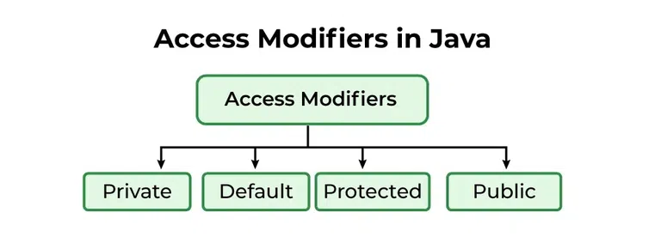
Visibility Modifiers Visibility modifiers control access to classes, methods, and variables. The main types are: public: Accessible from any other class. private: Accessible only within the same class. protected: Accessible within the same package and subclasses. default (no modifier): Accessible only within the same package. Understanding these concepts is crucial for effective object-oriented programming in Java.

Slide 7
Visibility Modifiers Visibility modifiers control access to classes, methods, and variables. The main types are: public: Accessible from any other class. private: Accessible only within the same class. protected: Accessible within the same package and subclasses. default (no modifier): Accessible only within the same package. Understanding these concepts is crucial for effective object-oriented programming in Java.

Slide 8
default
package defaultPackage;
class Demo{
void message(){
System.out.println("This is a message");
}
}

Slide 9
public class
// Animal.java file
// public class
public class Animal { // public variable
public int legCount;
// public method
public void display() {
System.out.println("I am an animal.");
System.out.println("I have " + legCount + " legs."); }}
// Main.java
public class Main {
public static void main( String[] args ) {
// accessing the public class
Animal animal = new Animal();
// accessing the public variable
animal.legCount = 4;
// accessing the public method
animal.display();}}

Slide 10
private variable
class Data
{
// private variable
private String name;}
public class Main
{ public static void main(String[] main)
{
// create an object of Data
Data d = new Data();
// access private variable and field from another class d.name = “me"; }}

Slide 11
protected method
class Animal {
// protected method
protected void display() {
System.out.println("I am an animal");
}
}
class Dog extends Animal {
public static void main(String[] args) {
// create an object of Dog class
Dog dog = new Dog();
// access protected method
dog.display();
}
}

Slide 12
Java Methods and Functions
In Java, the terms “method” and “function” are often used interchangeably, but strictly speaking, Java only has methods. A method is a block of code that performs a specific task and is associated with an object or a class. Unlike some other programming languages (like Python or JavaScript) where functions can exist independently, all executable code in Java resides within a class, and thus, within a method.Key Characteristics of Java Methods:
1.Part of a Class: Every method in Java must be defined inside a class. It cannot exist on its own.
2.Performs a Task: Methods are designed to perform a specific action or computation.
3.Reusability: Methods promote code reusability. Once a method is defined, it can be called multiple times from different parts of the program without rewriting the code.
4.Parameters and Return Values: Methods can accept input values (parameters or arguments) and can return a single output value. If a method does not return any value, its return type is void.
5.Access Modifiers: Methods can have access modifiers (e.g., public, private, protected, default) that control their visibility and accessibility from other classes.
6.Static vs. Instance Methods:
◦Instance Methods: These methods belong to an object (an instance of a class) and can access instance variables and other instance methods. They are called using an object of the class.
◦Static Methods: These methods belong to the class itself, not to any specific object. They can be called directly using the class name and can only access static variables and static methods. They cannot access instance variables or instance methods directly.￼

Slide 13
public class Calculator {
public int add(int a, int b) // Instance method to add two numbers
{ int sum = a + b;
return sum; }
public static int multiply(int x, int y) // Static method to multiply two numbers
{ return x * y; }
// Method with void return type (does not return any value)
public void displayMessage(String message) {
System.out.println(message);
}
public static void main(String[] args) {
// Calling an instance method requires an object
Calculator myCalculator = new Calculator();
int resultAdd = myCalculator.add(10, 5);
System.out.println("Sum: " + resultAdd); // Output: Sum: 15
// Calling a static method using the class name
int resultMultiply = Calculator.multiply(4, 6);
System.out.println("Product: " + resultMultiply); // Output: Product: 24
// Calling a void method
myCalculator.displayMessage("Hello from Java method!"); // Output: Hello from Java method!
}
}

Slide 14
Constructor in Java
In Java, constructors and methods may look similar, but they serve different purposes. Here is a clear comparison between them:
Feature | Constructor | Method
Name | Must be the same as the class | name Can be any valid identifier
Return type | No return type (not even void) | Must have a return type (int, String, void, etc.)
Call | Called automatically when object is created (new ClassName()) | Called explicitly using object reference (obj.methodName)
Purpose | Used to initialize objects | Used to define behavior / perform operations
Inheritance | Not inherited by subclasses | Can be inherited and overridden
Overloading | Can be overloaded (different parameter lists) | Can also be overloaded
Default availability | Compiler provides default constructor if none is defined | No default method is provided

